Slide 1

Soft Computing
Jaya Sil
IIEST, Shibpur

Slide 2
What is soft computing
Soft computing (SC) is the reverse of conventional computing.
A group of computational techniques provide cost-effective solutions to the complex real-life problems.
Latif Zadeh coined the term soft computing.
The objective of soft computing is to provide precise approximation to the solutions of complex real-life problems.
Soft Computing Techniques simulate the human mind to develop the approximation models for solving the problems.
.

Slide 3
Conventional Computing vs Soft Computing
Conventional computing requires a precisely stated analytical model, exact input and use bi-valued logic, crisp system, numerical analysis.
Soft Computing aims to exploit the tolerance for imprecision, uncertainty, approximate reasoning, and partial truth in order to achieve close resemblance with human decisions.
Hard computing is deterministic, soft computing is stochastic.
It is the composition of methodologies designed to model and enable solution to real world problems.

Slide 4
Soft Computing
Soft computing (SC) term was coined by “Lotfi A. Zadeh” in 1981, now referred as computational intelligence.
SC includes Fuzzy Logic, Neuro-Computing, Evolutionary and Genetic Computing and Probabilistic Computing …….
SC solutions are unpredictable, uncertain and between 0 and 1.
Complex systems in biology, medicine, humanities, management sciences, and other fields often remained intractable to conventional Mathematical and analytical methods.

Slide 5
Characteristics
Soft computing provides an approximate but precise solution for real-life problems.
The algorithms of soft computing are adaptive.
The concept of soft computing is based on learning/Reasoning using experimental data.
SC forms the basis of machine learning techniques.
Soft computing helps users to solve real-world problems by providing approximate results that conventional and analytical models cannot solve.

Slide 6
Paradigm Shift
Machine learning develops algorithms, operate on a model, which is built from observations in order to make data-driven predictions or decisions.
Supervised, Unsupervised, Reinforcement and semisupervised learning
Learning from experimental data → generalization → Approximating
Generalization using high dimensional space.
SC represents a significant paradigm shift in the aims of computing.

Slide 7
Soft Computing Methods
The main constituents of soft computing are fuzzy-logic-based computing, neurocomputing, Rough set and genetic algorithms.
Fuzzy logic contributes the capability of approximate reasoning, neurocomputing offers function approximation and learning capabilities, Rough set is set approximation instead of crisp and genetic algorithms provide a methodology for systematic random search and optimization.
These three capabilities are combined in a complementary and synergetic fashion.

Slide 8
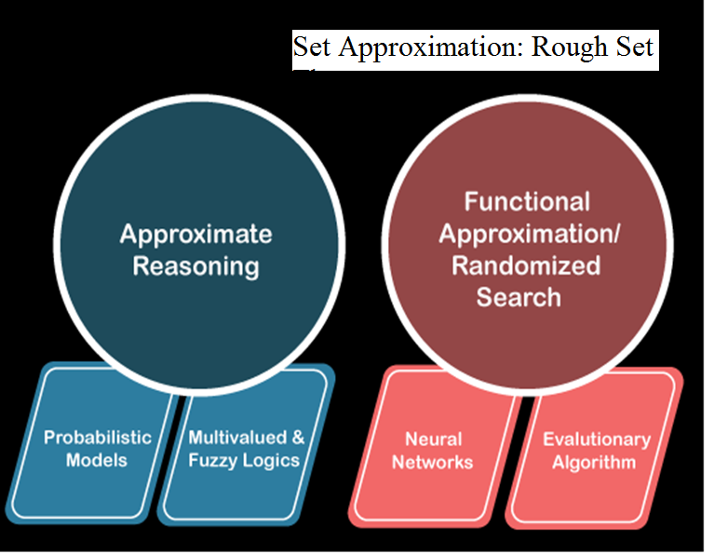

Slide 9
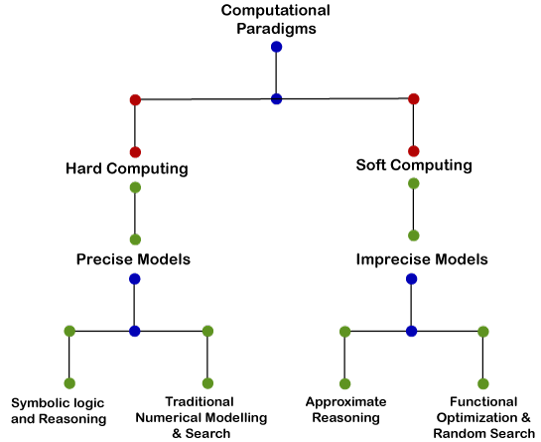

Slide 10
Objectives
Exploit uncertainty to achieve robustness: Fuzzy Set Theory
Adapt by learning mechanism to perform better in changing environments – Neural Network
Systems explain how they make decisions or take actions – Neuro-Fuzzy Systems problems.
Handling inconsistency in information using Rough Set Thoery-Set Approximation.
Two features: “adaptivity” and “knowledge extraction”

Slide 11
Objectives
Derivative-free optimization methods using Systematic Random search
Biologically inspired computing and cognitive computing
Distributed computing and Fault tolerant
Handle nonlinear and Complex problems

Slide 12
Soft Computing and AI
Hybrid Intelligent Systems
Agents and Multiagent Systems
Clustering and Multiclassfier Systems
Intelligent Robot Controller
Metaheuristics and Optimization Models
Computer vision
Bioinformatics

Slide 13
Data Mining
Data Availability:
Wide availability of huge amount of data: variability, speed, volume
Need to be turned into useful information and knowledge
Knowledge applied in business management, market analysis, engineering design, science exploration etc.

Slide 14
The process

Slide 15
Evolutionary Algorithms
A population of individuals exists in an environment with limited resources.
Competition for the resources causes selection of the individuals who are fitter in the environment (better adapt the environment).
Individuals act as seeds for the generation of new individuals.
The new individuals have their fitness evaluated and compete for survival.
Over time Natural selection causes a rise in the fitness of the population.

Slide 16
Evolutionary Algorithms
A population of individuals exists in an environment with limited resources.
Competition for the resources causes selection of the individuals who are fitter in the environment (better adapt the environment).
Due to population based approach EA have advantage over classical optimization techniques.
EA maintains a population of possible solutions, which are processed at every generation.
Multiple solutions mean multiple good solutions, rather than only the best solution.

Slide 17
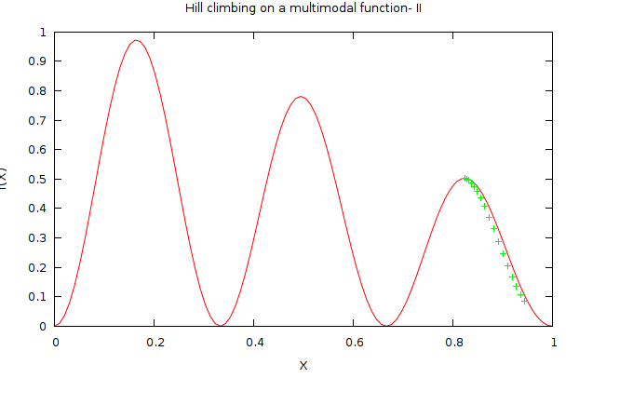
Multimodal Function Multimodal optimization deals with optimization tasks that involve finding all or most of the multiple solutions (as opposed to a single best solution) to a problem.

